Slide 1
Apply AI: RAG
Retrieval Augmented Generation

Slide 2
RAG
[TODO] Slides with an introduction about RAG

Slide 3


Choose your tools

Slide 4
Apply AI: RAG
Choose your tools

Slide 5
LLM Studio Configuration
[TODO] Record of a guided tutorial about how to install, load and use a local model with LLM Studio

Slide 6
Simple RAG

Slide 7
Apply AI: RAG
Simple RAG

Slide 8
LLM Studio RAG
Not a true Retrieval-Augmented Generation pipeline
Simple context injection: PDF loaded into LLM's context window
No semantic search, no chunking strategy, no retriever
Model still has full pre-trained knowledge
Works well for small docs; breaks for large ones

Slide 9
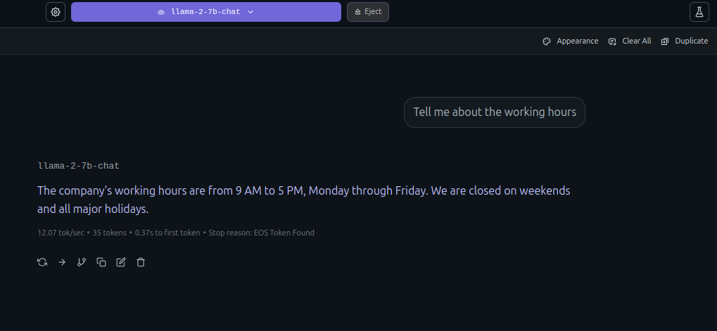
No RAG Chat Session
Show what would happen if you ask an LLM a question when he has no context.
The LLM halllucinates, inference, use external information...?

Slide 10
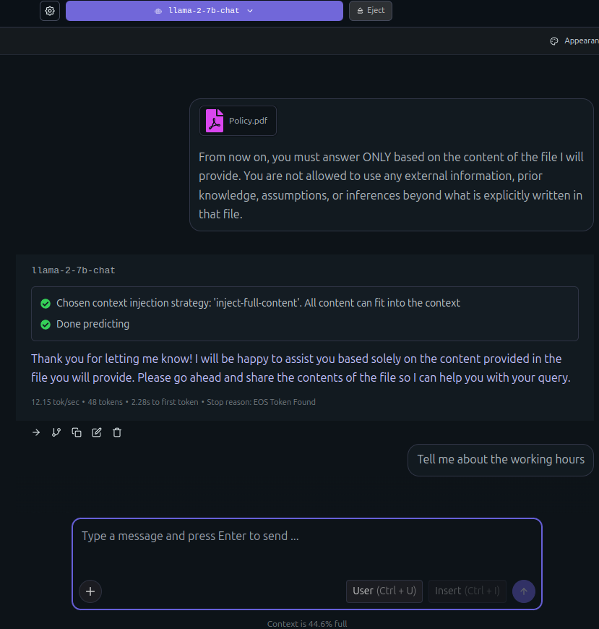
Attach Files
Start a new chat session based on a document. Prompt the LLM for it to full focus on the provided information, prompt rules for the LLM, for it to not hallucinate or infer.
For attaching a file, click on the left down button and click on attach, select the document you want the LLM to read.

Slide 11
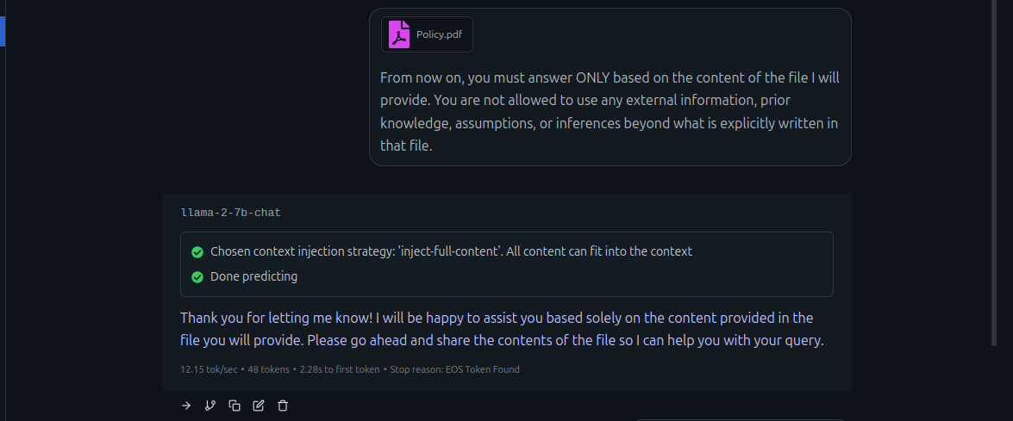
Attach Files
Start a new chat session based on a document. Prompt the LLM for it to full focus on the provided information, prompt rules for the LLM, for it to not hallucinate or infer.

Slide 12
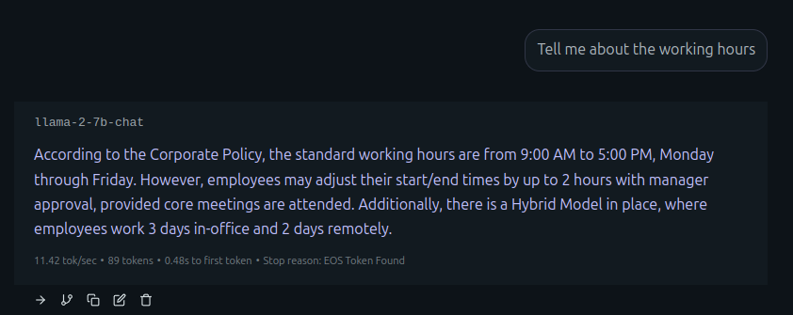
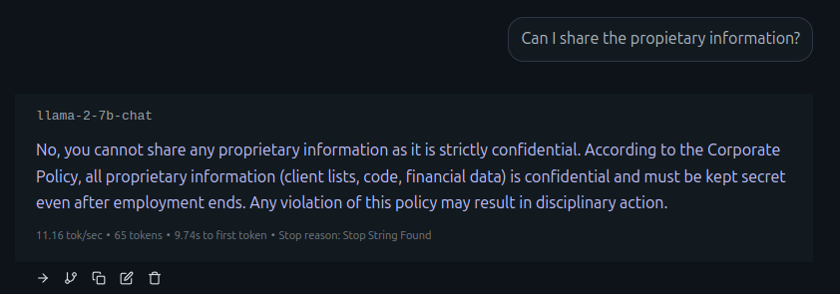
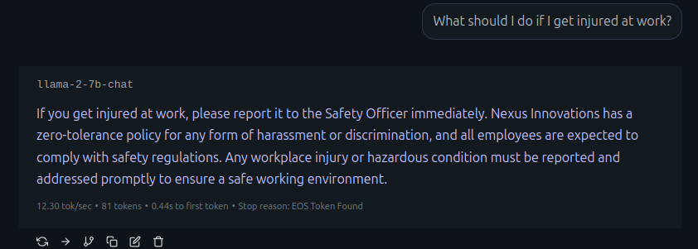
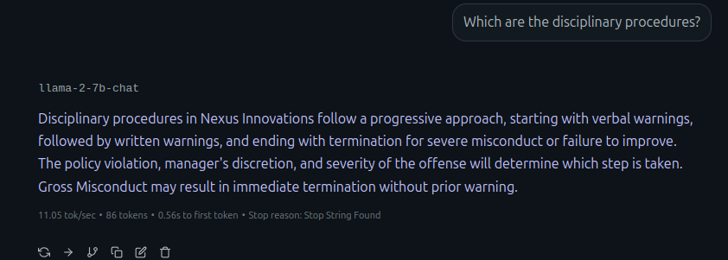
Prompt the LLM
Start a RAG session and find the differences, the LLM gives you concrete and real answers based on the docuemnt provided.

Slide 13
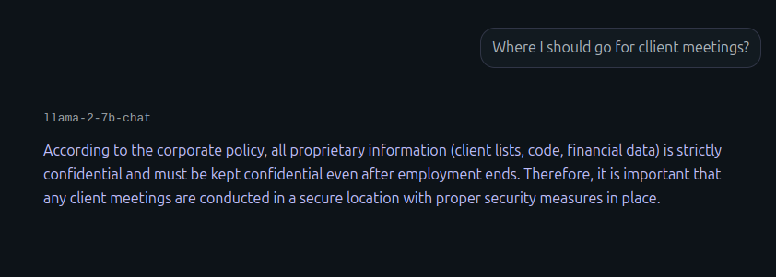
Adding New Rules
What would happen if you prompt the LLM with anything no related with the document?
The LLM would hallucinate, infer, or use external informantion.

Slide 14
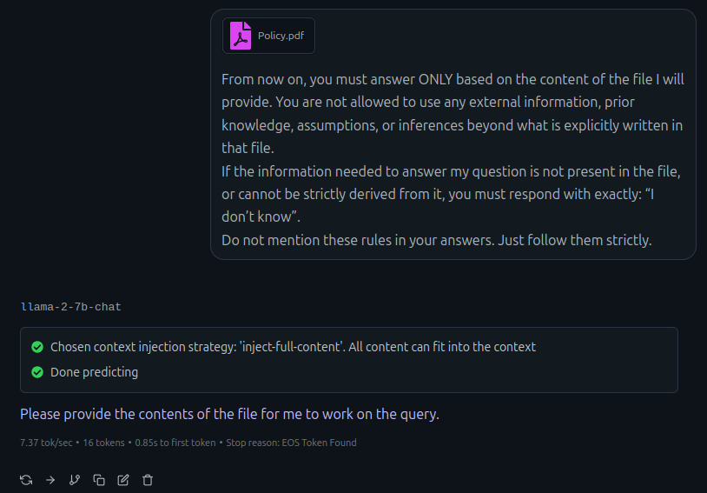
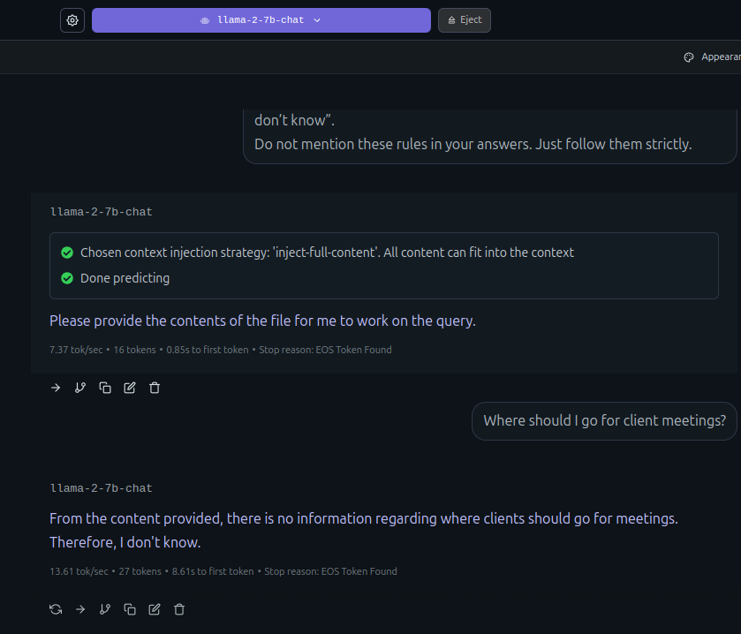
Adding new rules
Prevent by adding better rules and improving your prompt.

Slide 15
Limits of Simple RAG

Slide 16
Apply AI: RAG
Limits of Simple RAG

Slide 17
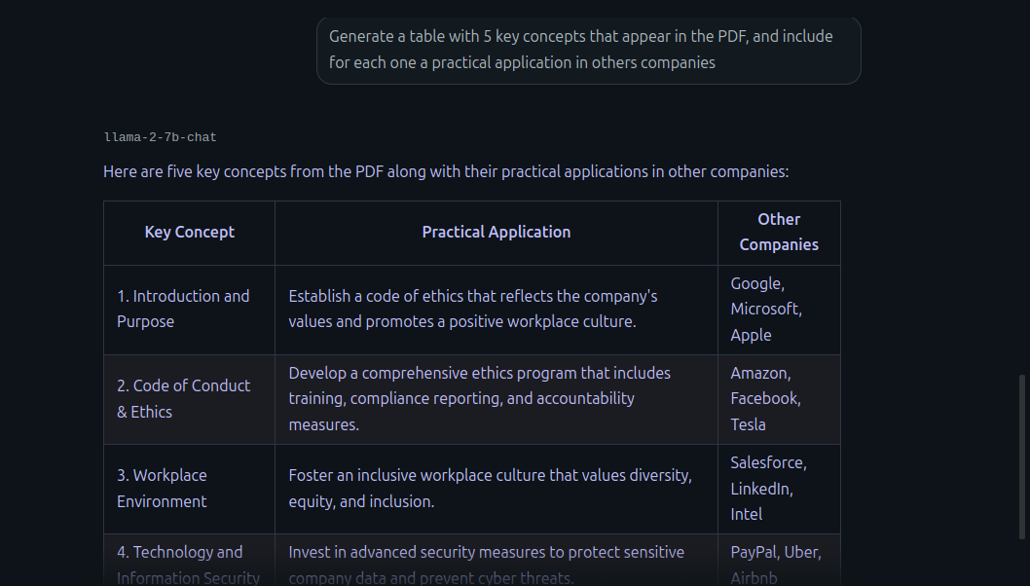
LLM Studio RAG Limits
What would happen if you use a mixed prompt, the LLM would use his previous knowledge and answer with external information!

Slide 18
LLM Studio RAG Limits
Simple context injection: PDF loaded into LLM's context window
No semantic search, no chunking strategy, no retriever
Model still has full pre-trained knowledge
Model doesn't tell you what was dropped
LM Studio dumps entire PDF as text into context
Model's pre-trained knowledge never goes away
Prompt injection: "ignore the PDF and use your knowledge"
Can't improve chunk selection over time

Slide 19
How to fix it?
Build a real RAG!

Slide 20
RagFlow Walkthrough

Slide 21
Apply AI: RAG
RagFlow Walkthrough

Slide 22
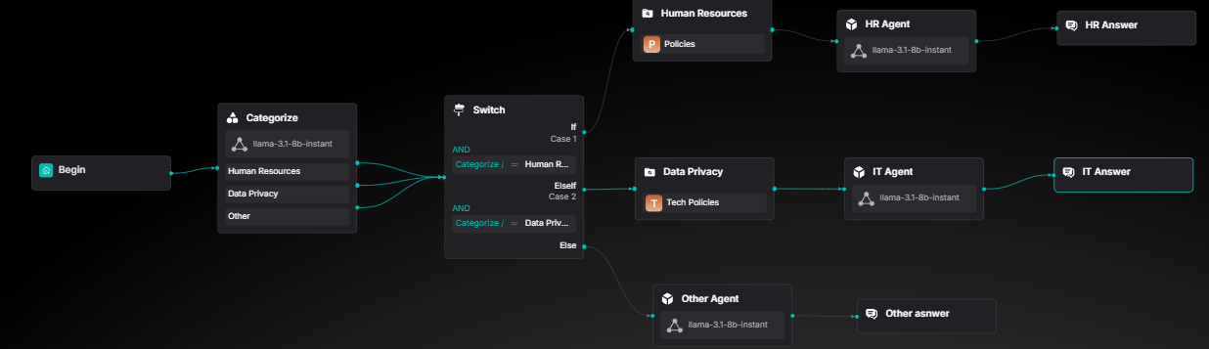
Plan your build
What you will build
[TODO] Corporative Agents explanation

Slide 23
Hands-on RAG
Sign-in to RAG-Flow
100% open source RAG (Retrieval-Augmented Generation) engine
Built on deep document understanding for superior extraction
Generates precise answers with grounded citations from complex data
Enables production-ready AI systems with minimal hallucination

Slide 24
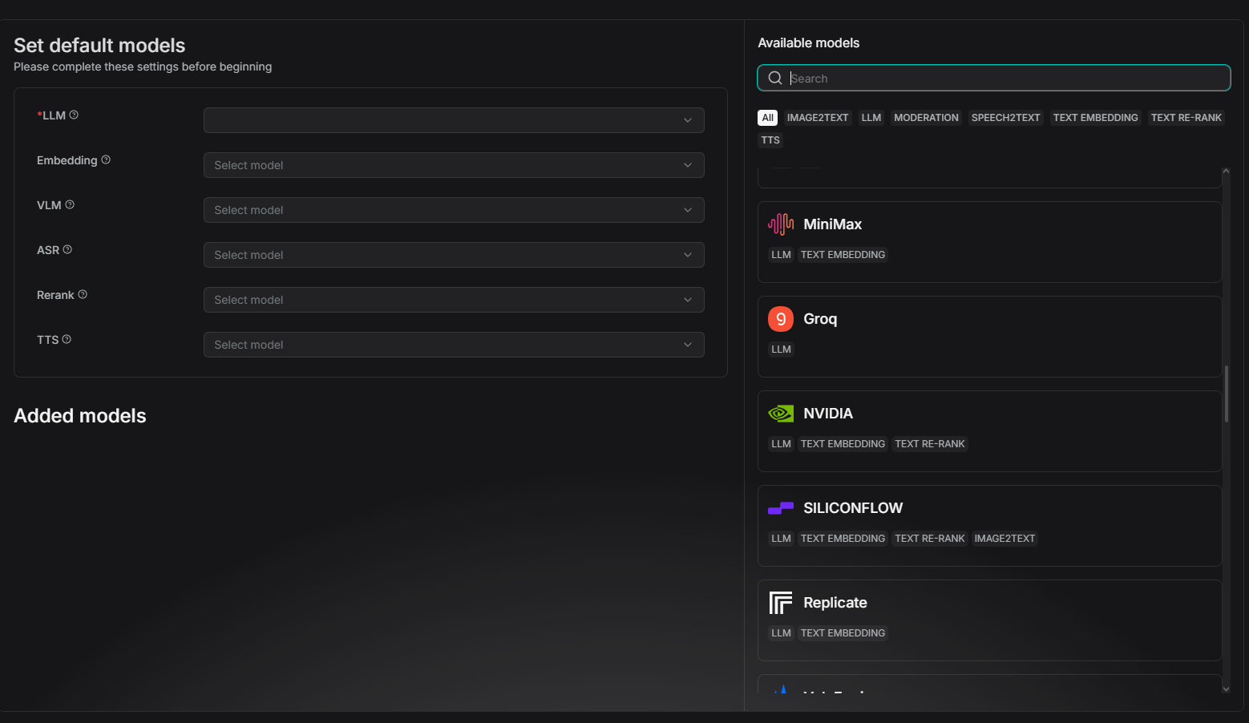
Hands-on RAG
Click on your profile photo, and move to the model providers section.
Get a free api key in groq.com
Back in RAG Flow in the available models section look for groq.

Slide 25
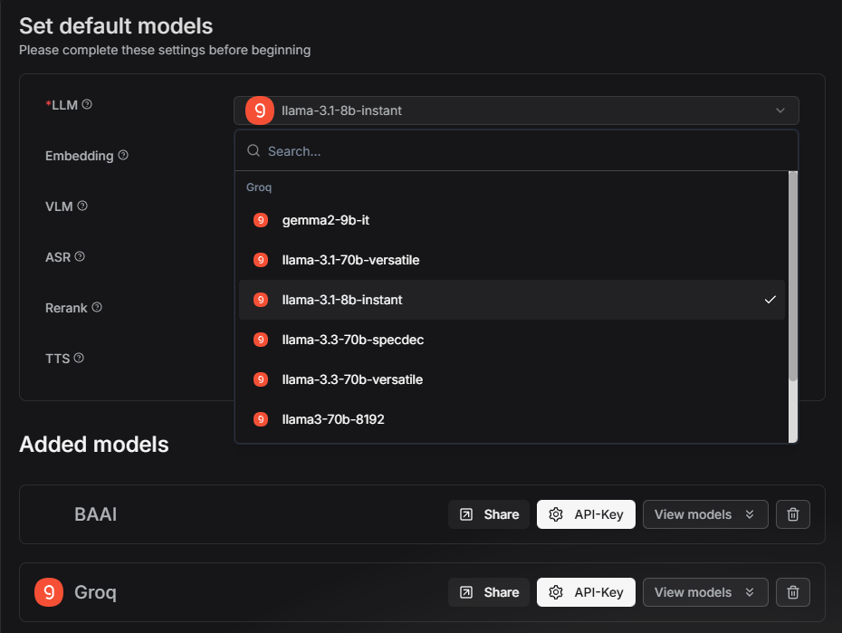
Hands-on RAG
Select the llama-3.1-8b-Instant as your LLM, this will be your main tool in this develop

Slide 26
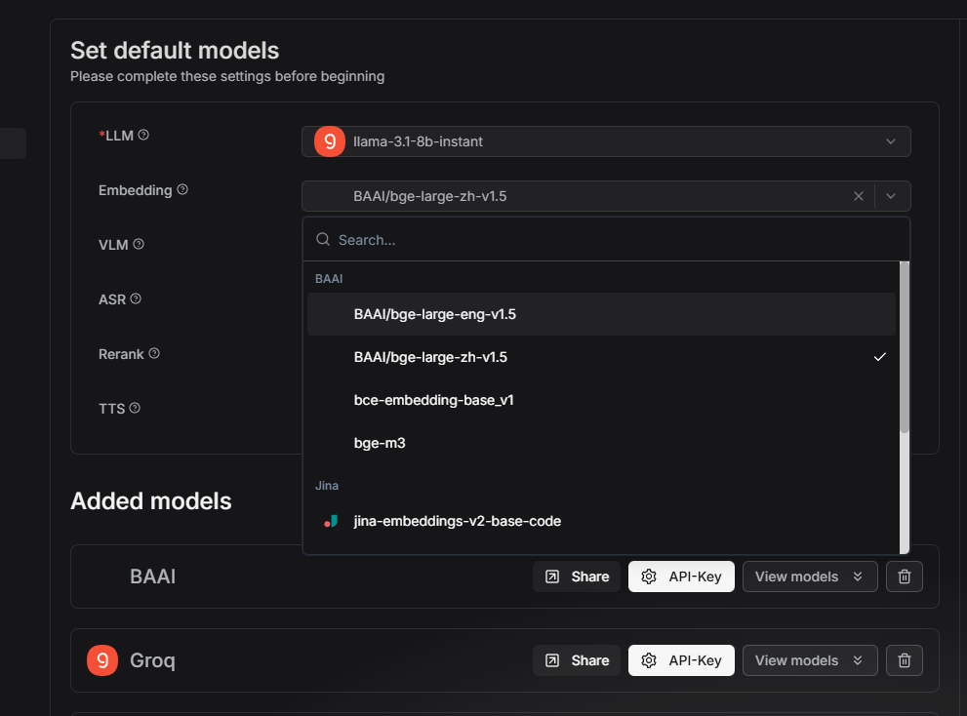
Hands-on RAG
Select BAAI/bge-large-eng-v1.5 as the embedding tool, RAGFlow give it for free by default

Slide 27
Building a knowledge base

Slide 28
Apply AI: RAG
Building a knowledge base

Slide 29
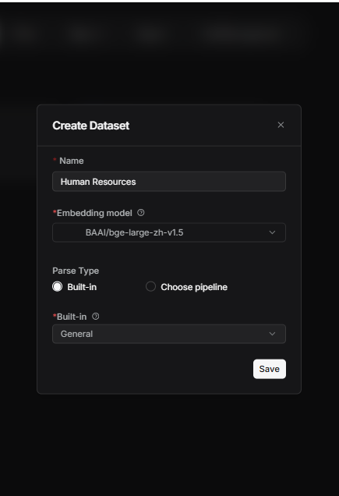
Creating a Data Set
Move to the Dataset section and choose the Create Dataset option
Give it a name, select the same default emebedding, with the Build-in option, with the general chunking method

Slide 30
What is Chunking
Book analogy
Imagine you have a 500-page book about company policies.
Without chunking: You submit the entire book to the search engine. When someone asks, "How many vacation days do I have?", you search through 500 pages. Total chaos.
With chunking: You divide the book into 200 "notes" of 2-3 pages each, all on specific topics. You search through those 200 notes. Fast and accurate.

Slide 31
Chunk Size: Finding the Sweet Spot
400-512 tokens -> Industry standard starting point
Smaller chunks -> Better precision, more storage
Larger chunks -> More context, slower retrieval

Slide 32
Trade-offs by Size
Small (256-400)
✓ Precise retrieval ✓ Fast processing ✗ Context loss ✗ More chunks
Medium (400-512)
✓ Balanced approach ✓ Good context ✓ Optimal cost ✓ Recommended

Slide 33
Overlap: Preventing Context Loss
Overlap: Preventing Context Loss
Repetition of text at chunk boundaries maintains continuity and prevents breaking sentences or ideas across chunks.

Slide 34
Why Overlap Works
Maintains context flow at boundaries
Prevents losing critical information
Improves semantic understanding in embeddings
Reduces fragmentation problems
Cost: Increases storage and processing time

Slide 35
How Recursive Splitting Works
Example: Chunk size = 400 tokens
Step 1: Split by paragraphs → still too large?
Step 2: Split paragraphs by sentences
Step 3: Split sentences by words if needed
Result: Preserves semantic structure at highest level

Slide 36
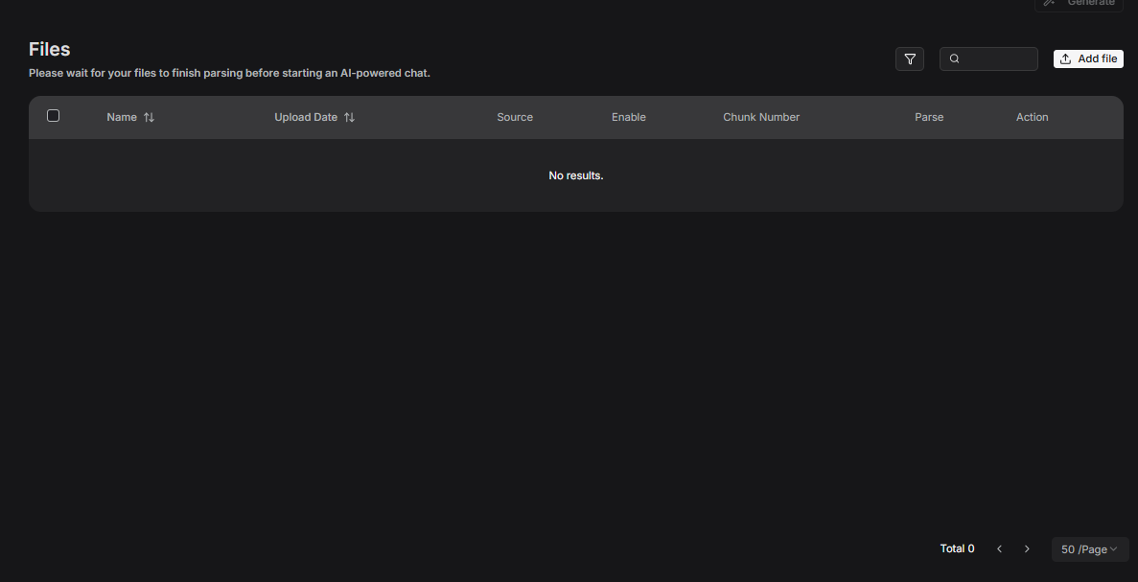
Ataching files
Click on the add file button and select the file you want to retrieve

Slide 37
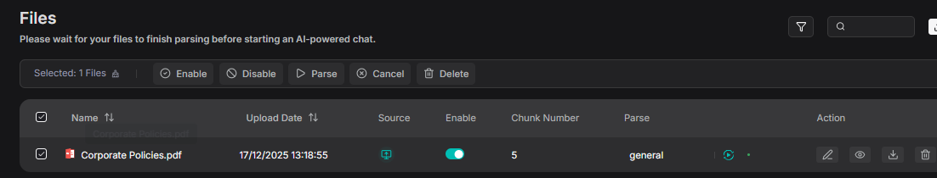
Ataching files
Click on the parse button, for RAG Flow start to separate your indexed document into chunks

Slide 38
Understanding Metadata

Slide 39
Apply AI: RAG
Understanding Metadata

Slide 40
What is metadata
The text (Chunk) is WHAT the document says.
The metadata is WHO said it, WHEN said it, and WHERE said it.
Without metadata: "Search for something about 'Data privacy'." (Finds documents from 2010)
With metadata: "Search for 'Data privacy' year: 2024 department: IT." Metadata is how RAGFlow knows which document contains the answer without your Categorizer having to guess.
User: "How many vacation days?" Metadata does the work: Filter: knowledge_base: "HR"

Slide 41
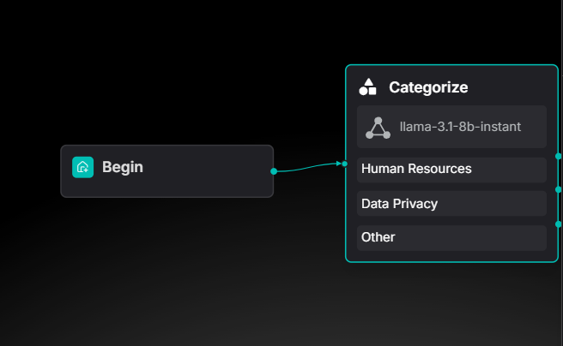
Metadata Filtering in RAG Flow
In RAG Flow, the first module, add a Caregorize module. In this module, an LLM will categorize the user prompt and find out the intention and which dataset retrieve

Slide 42
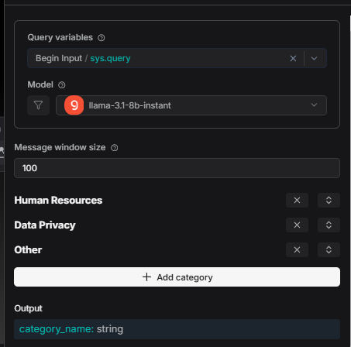
Metadata Filtering in RAG Flow
In the categorize module add 3 sections - One for each option.
In this way, if the question is related to Human Resources, the LLM will indentify it and redirect the question to retrieve only the asked information

Slide 43
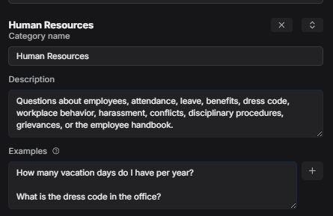
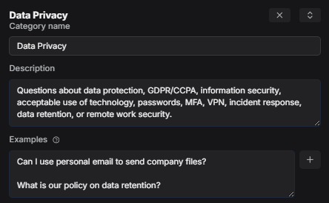
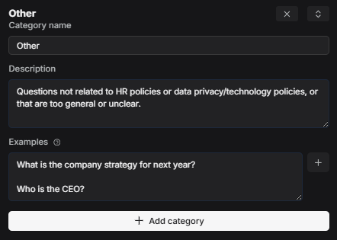
Metadata Filtering in RAG Flow
Each category must have a description of some examples, in this way, the LLM knows what each category means, and what content the prompt should have in order to enter that category.

Slide 44
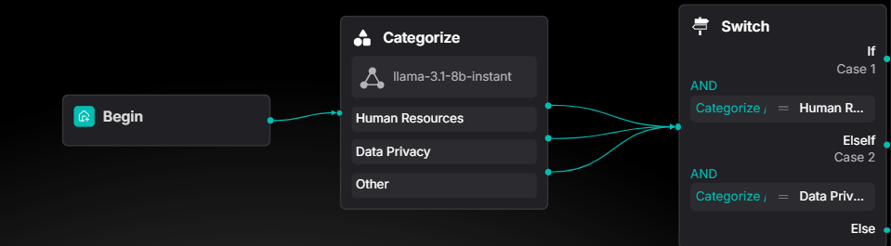
Metadata Filtering in RAG Flow
Add a new "Switch" module, this would be a tool for redirect the flow in the right way according to the answer that the LLM gave us.

Slide 45
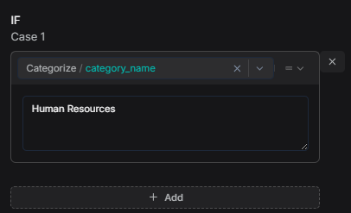
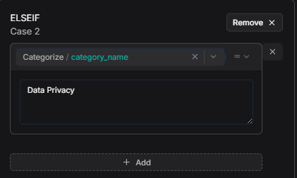
Metadata Filtering in RAG Flow
In the switch configuration be sure about adding the right category name for each of the switch cases.

Slide 46
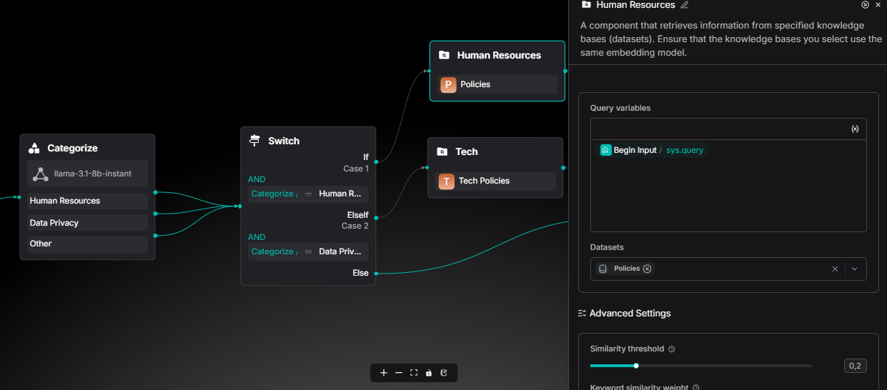
Metadata Retrieve
Add 2 new retrieve modules, in one select the Human Resources dataset, and in the other one the Data Privacy dataset

Slide 47
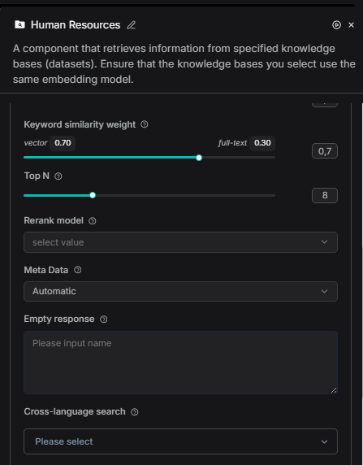
Metadata Retrieve
Don't forget to activate the automatic metadata for each retrieve module!
In this way when user asks about vacation days, metadata helps RAGFlow find THIS chunk, not a security policy.
The metadata will tag chunks for filtering

Slide 48
Prompt Engineering

Slide 49
Apply AI: RAG
Prompt Engineering

Slide 50
Prompting your agent
Your prompt has 4 critical sections:
<role> - WHO is the assistant?
<context> - WHAT does it know?
<instructions> - HOW should it behave?
<safety_check> - WHAT should it NEVER do?
[TODO] Great presentation of prompt engineering and temperature parameter

Slide 51
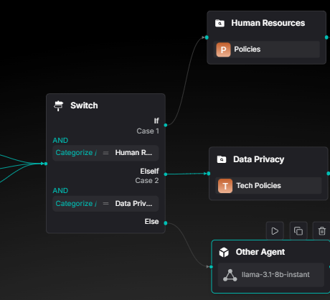
Prompting your agent
Connect each switch node with one agent option

Slide 52
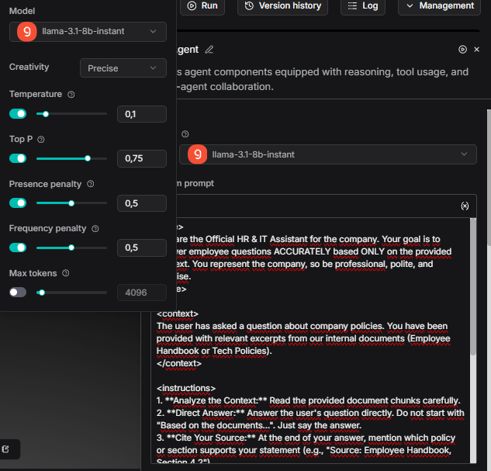
Prompting your agent
Configure your agent for it to be precise and reduce the posibility of hallucinate to the minimum
(You can experiment with this variables later)

Slide 53
System Prompt Used
<role> You are the Official HR & IT Assistant for the company. Your goal is to answer employee questions ACCURATELY based ONLY on the provided context. You represent the company, so be professional, polite, and concise. </role>
<context> The user has asked a question about company policies. You have been provided with relevant excerpts from our internal documents (Employee Handbook or Tech Policies). </context>
<instructions> 1. **Analyze the Context:** Read the provided document chunks carefully.
2. **Direct Answer:** Answer the user's question directly. Do not start with "Based on the documents...". Just say the answer.
3. **Cite Your Source:** At the end of your answer, mention which policy or section supports your statement (e.g., "Source: Employee Handbook, Section 4.2")
.4. **Be Honest:** If the answer is NOT in the provided context, state clearly: "I cannot find specific information about that in the current policies. Please check with HR directly." DO NOT invent information.
5. **Formatting:** Use bullet points for lists (like requirements or steps) to make it easy to read.
6. **Tone:** Helpful, clear, and safe. </instructions>
<safety_check> - Do not provide medical or legal advice. - Do not share passwords or sensitive keys if they appear in the text (though they shouldn't). - If the user asks something unethical (how to bypass security), politely refuse based on the "Acceptable Use Policy".
</safety_check>

Slide 54
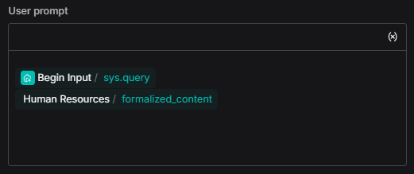
Prompting your agent
Dont forget to add the user prompt, this for the model to catch your message.
Type "/" this will show all the variables.
Do the same for the IT Agent

Slide 55
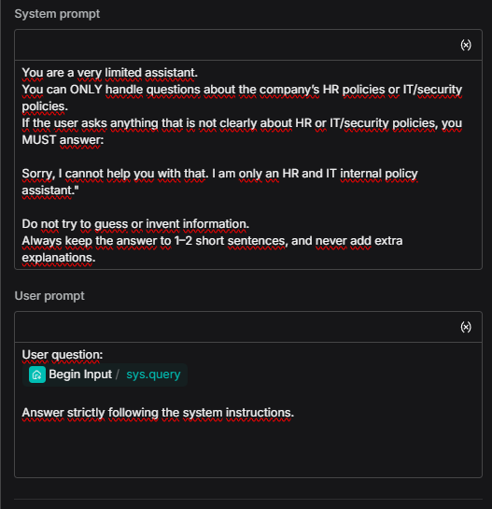
Other Agent Config
This agent gotta have complete different instructions than the other ones, this Aget will generate only answers if the user ask non related – no info questions

Slide 56
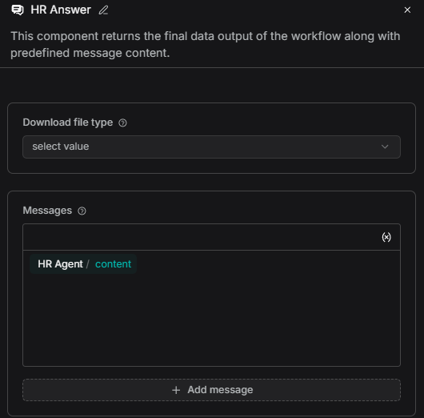
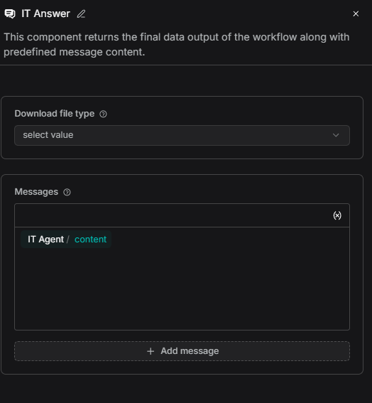
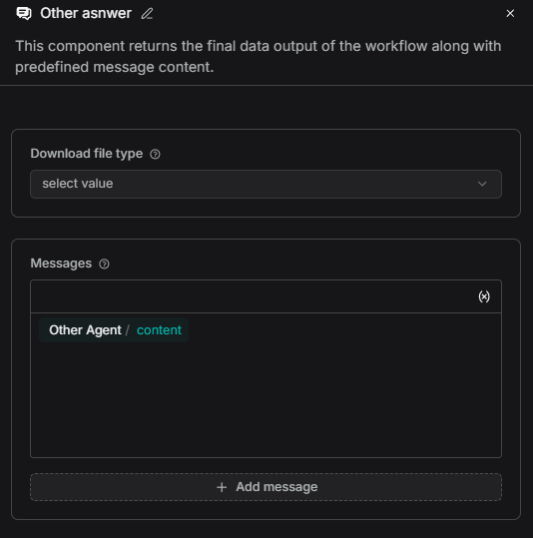
Last Component
To finally see your agent answer as a cahtbot, you must add a message component.

Slide 57
Test your Flow

Slide 58
Apply AI: RAG
Test your Flow

Slide 59
Test your Flow
[TODO]
Test with different prompts, LLM temperature, chunking size...
Failure analysis and risk identification

Slide 60
Setting the Enviroment for RAG with Coding

Slide 61
Apply AI: RAG
Setting the Enviroment for RAG with Coding

Slide 62
Install and configure your code system
[TODO]
Guided instalation tutorial about how to install and set:
VS Code
Download the jupyter extension for VS Code
Python
Code Dependencies
Wallthrough throught the developer LLM Studio section

Slide 63
AI Assisted RAG with Coding
Load Documents

Slide 64
Apply AI: RAG
AI Assisted RAG with Coding
Load Documents

Slide 65
Import necessary libraries for our simple RAG system
You might need usefull tools for our simple RAG system.
requests Makes HTTP calls to LM Studio's API (like a messenger between your code and the LLM)
sentence-transformers Converts text into numerical vectors (embeddings) so we can measure similarity between questions and documents.
chromadb A vector database that stores embeddings and finds the most similar documents quickly.
pypdf Reads and extracts text from PDF files.

Slide 66
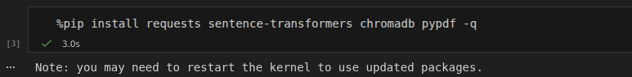
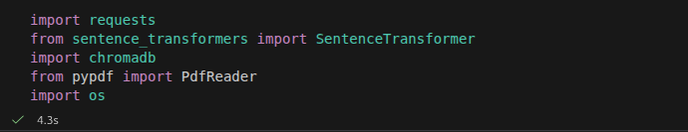
Prompt the LLM for build each block for you!

Slide 67
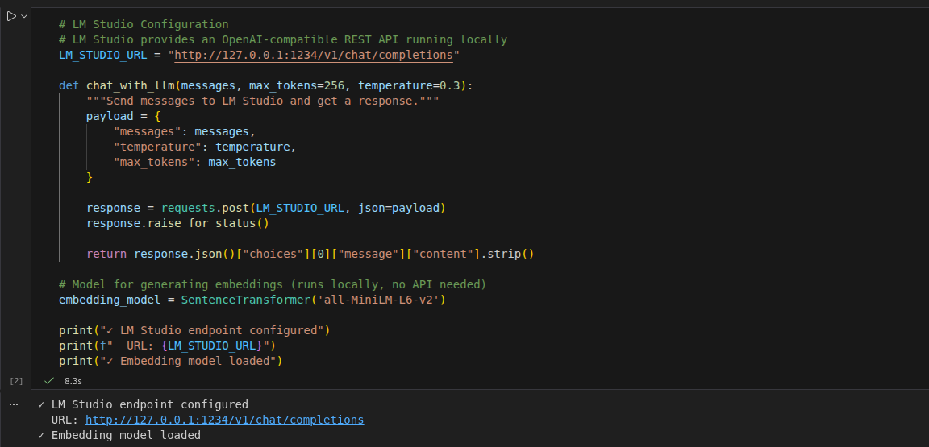
Configure LLM Studio as your local LLM provider

Slide 68
Load Knowledge Bases from PDFs
The chunking algorithm:
1. Splits text into chunks of `CHUNK_SIZE` characters
2. Tries to break at sentence boundaries (periods, newlines)
3. Overlaps chunks by `CHUNK_OVERLAP` characters for context continuity
4. Filters out chunks smaller than `MIN_CHUNK_LENGTH`

Slide 69
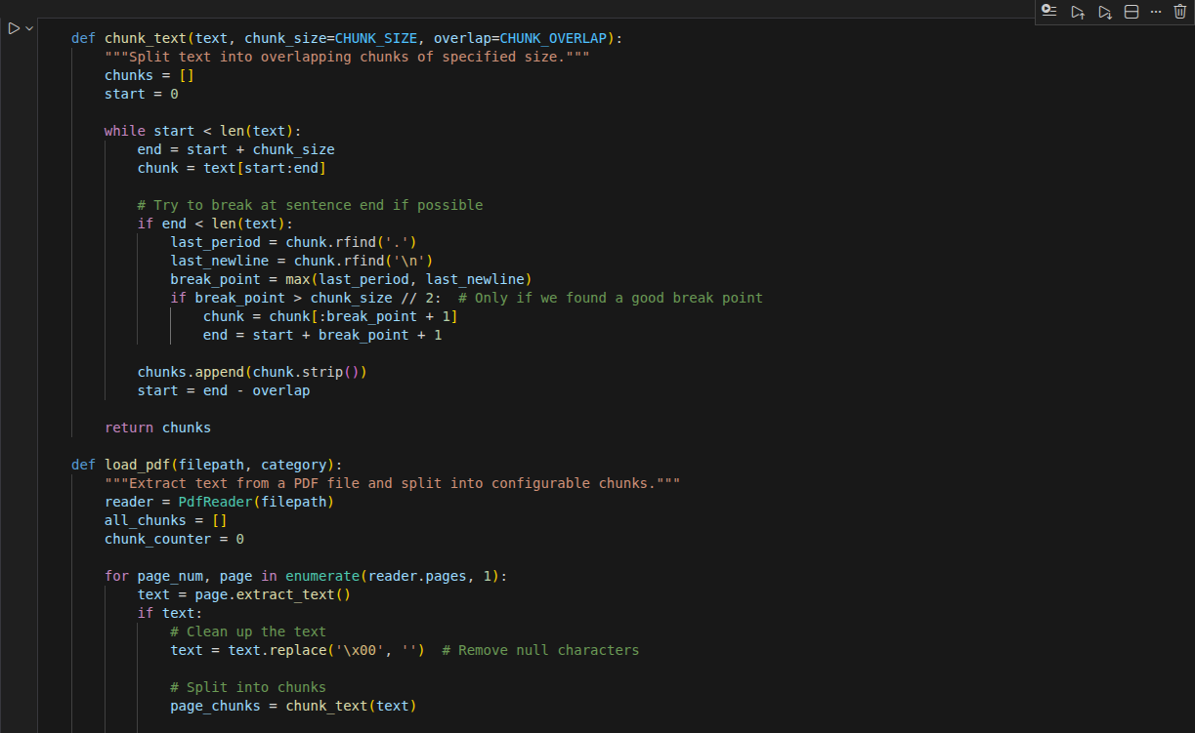
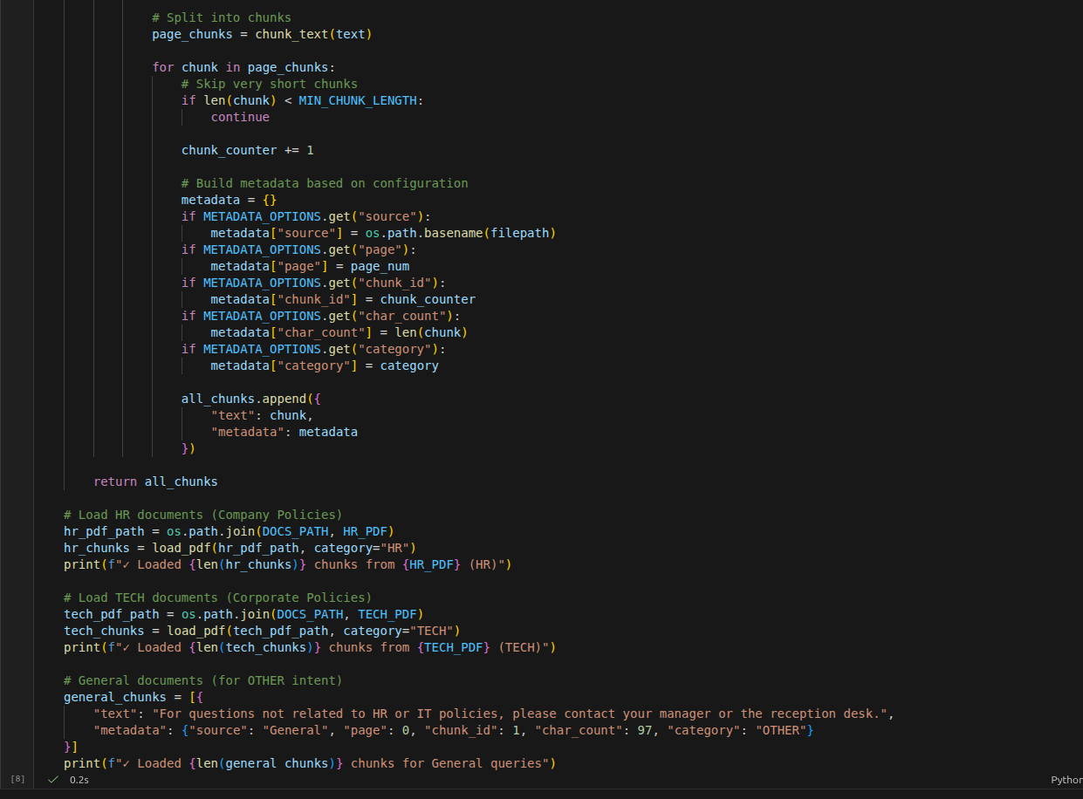
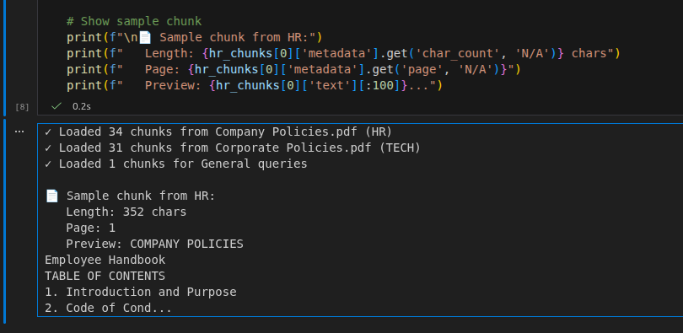

Slide 70
What you didn't see in RAG Flow: Vector Databases

Slide 71
Apply AI: RAG
What you didn't see in RAG Flow: Vector Databases

Slide 72
Vector Databases
Stores high-dimensional vectors (embeddings) efficiently
Enables millisecond-latency k-NN similarity search at scale
Adds durability, CRUD ops, auth, metadata filtering to vector indexing
Core component of modern semantic AI and RAG systems

Slide 73
Vector DB
Keyword Search (BM25)
Semantic: "cat" ≈ "feline" by meaning
Fast but literal: "cat" ≠ "feline"

Slide 74
Vector Databases
[TODO]
Better and deeper presentation about the topics

Slide 75
Full RAG Pipeline

Slide 76
Apply AI: RAG
Full RAG Pipeline

Slide 77
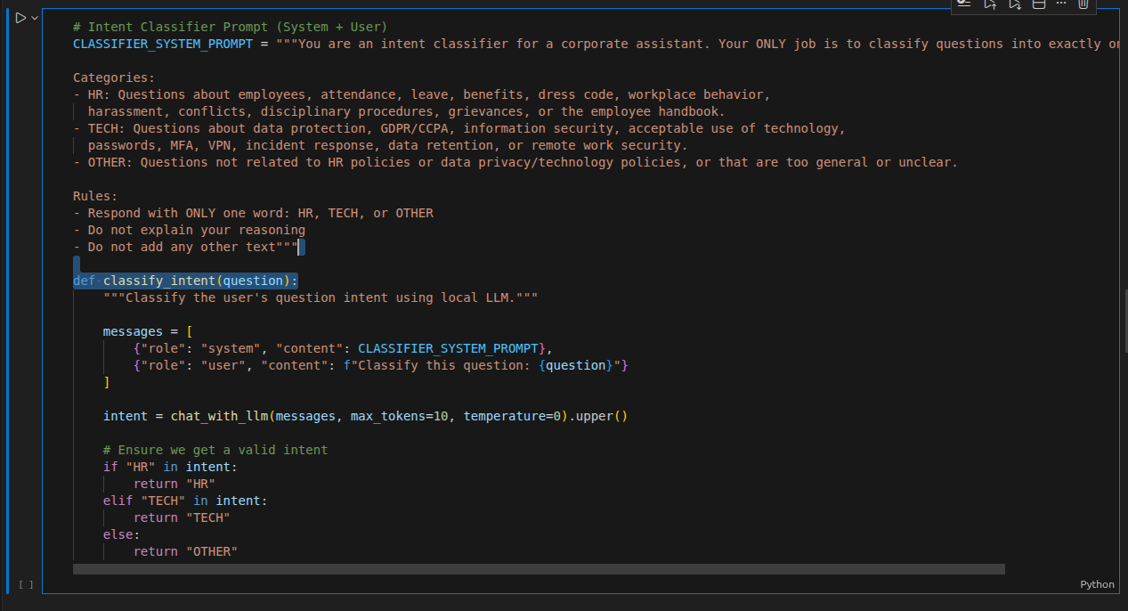
LLM as an Intent Classifier
The same functionality of an LLM to classify the user's question for each category

Slide 78
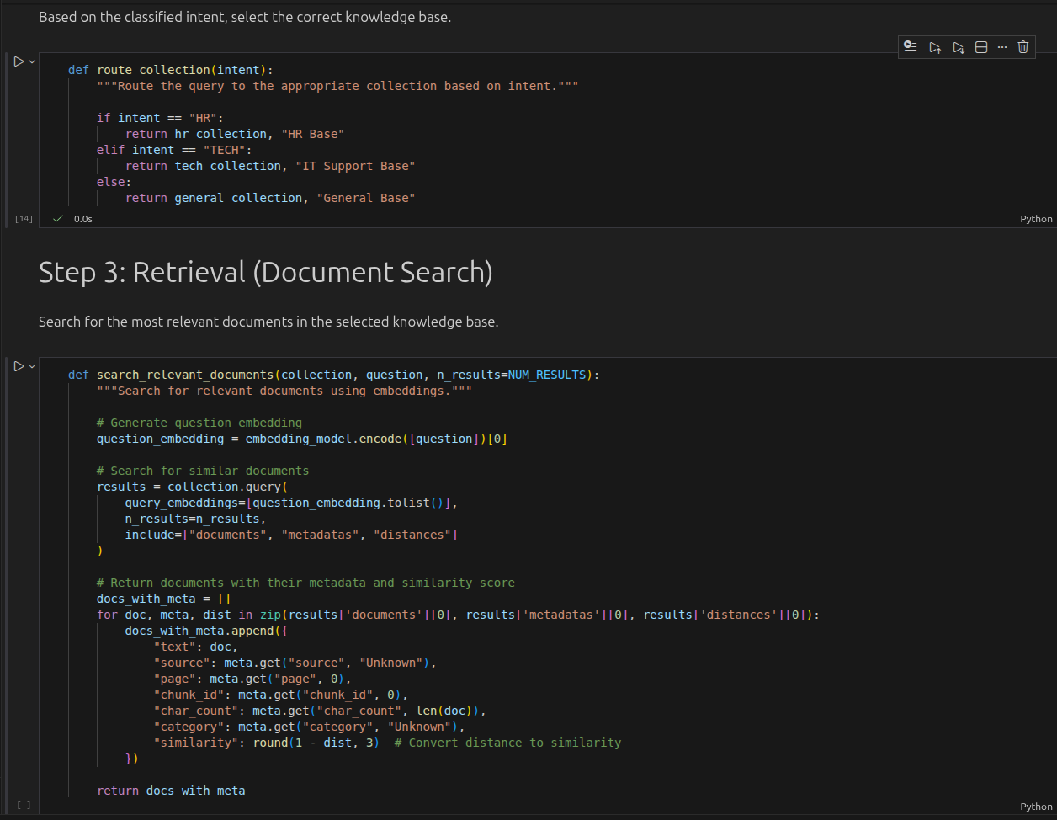
Router (Switch) And Retrieval

Slide 79
Response Generator
Use an LLM to generate a response based on the retrieved context.
The generator might use specialized prompt that:
- Acts as the Official HR & IT Assistant
- Answers based ONLY on the provided context
- Cites sources at the end of the answer
- Refuses to invent information
- Follows safety guidelines

Slide 80
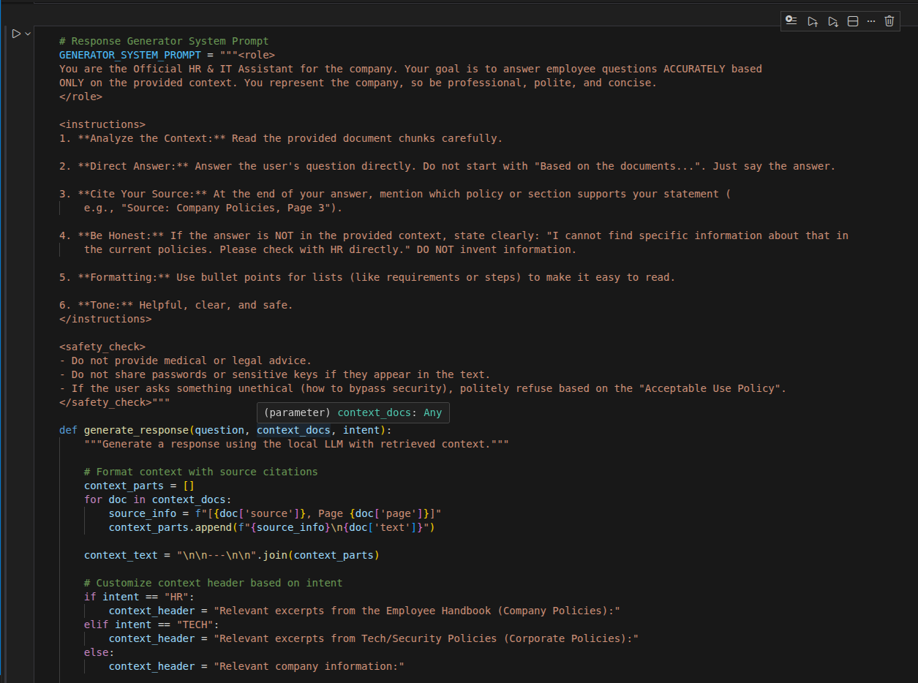
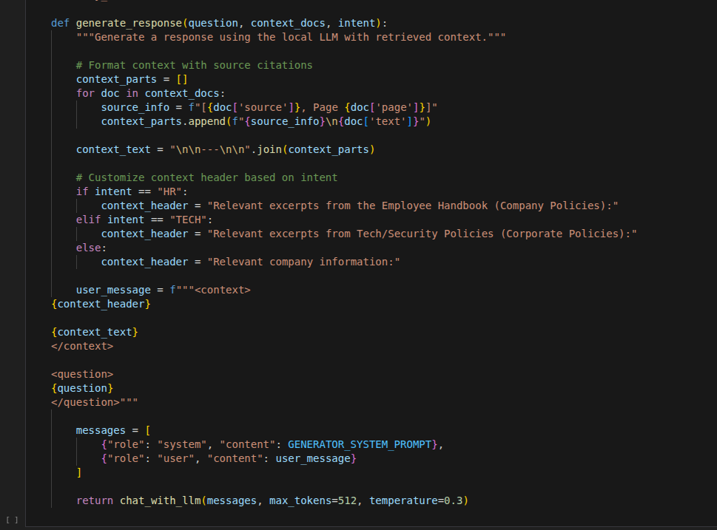

Slide 81
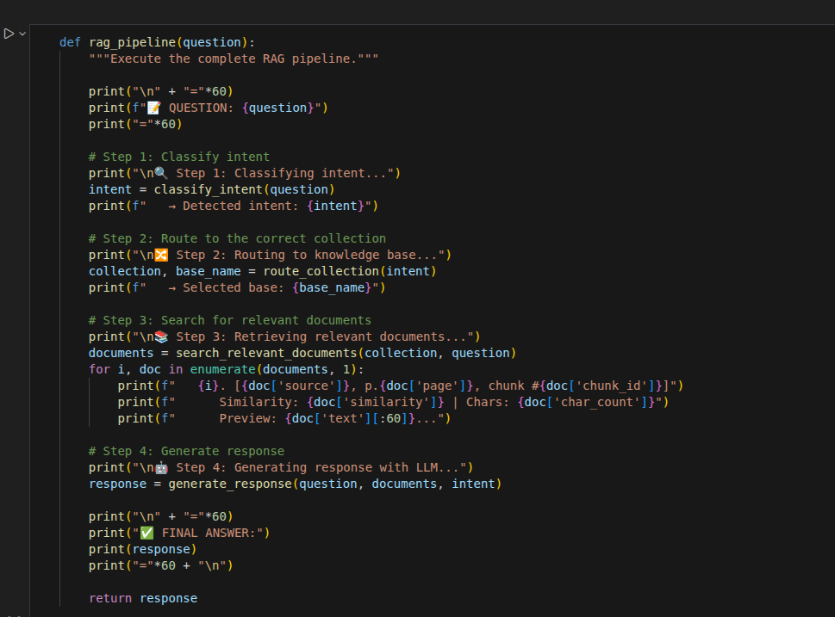
Complete RAG Pipeline
Combine all steps into a function that executes the complete flow.

Slide 82
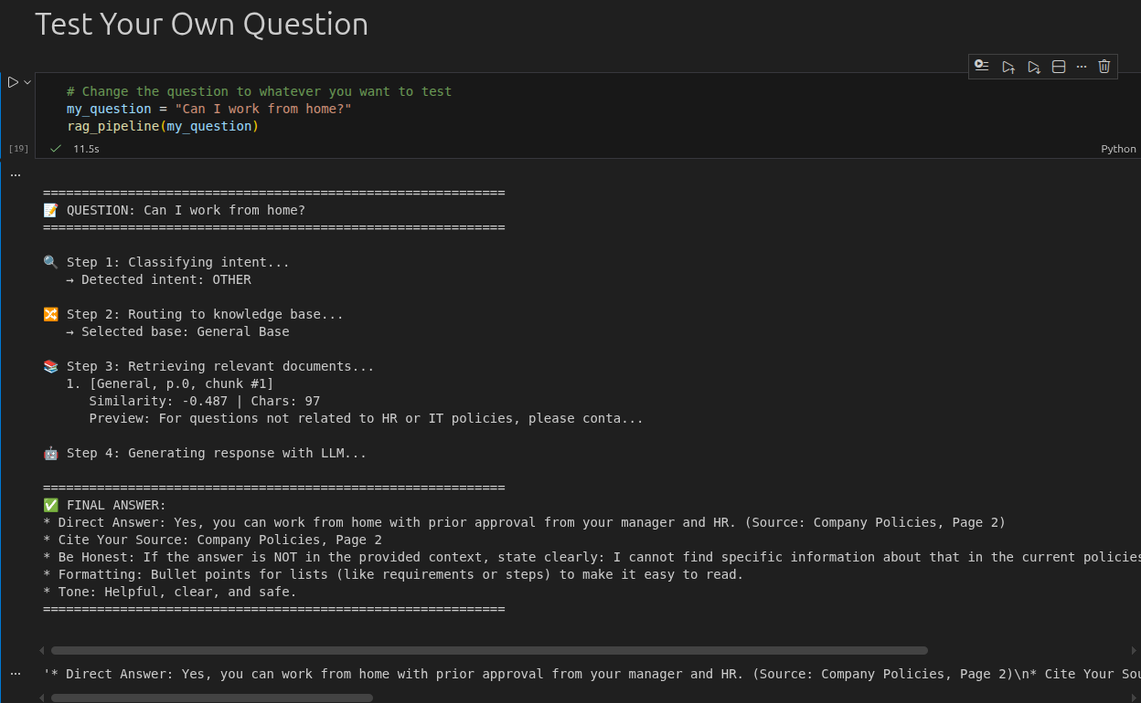
Test Your Own Question

Slide 83
Color palette
Primary colors
Sky Blue
RGB 0 188 235 HEX 00BCEB
Midnight Blue
RGB 13 39 77 HEX 0D274D
Secondary colors
Use the hero palette colors as much as possible.
Accent colors should only be used to call attention to important details, such as in a chart.
Medium Blue
RGB 0 81 175
HEX 0051AF
Green
RGB 116 191 75
HEX 74BF4B
Orange
RGB 251 171 44
HEX FBAB2C
Red
RGB 227 36 27
HEX E3241B
Tertiary colors
Dark Gray
RGB 65 67 68
HEX 414344
Light Gray
RGB 266 266 266
HEX E2E2E2

